Slide 1
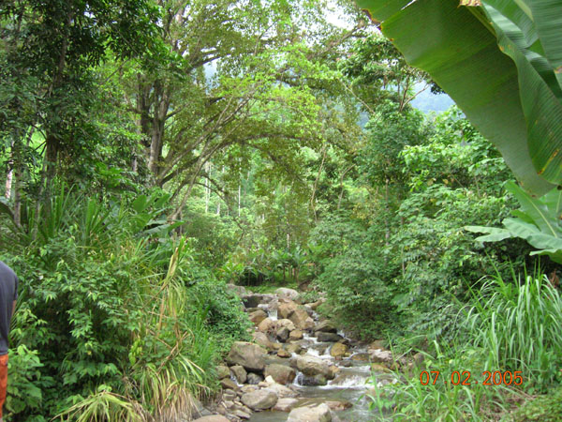
CHAPTER 1.1
ALIVE OR NOT???

Slide 2
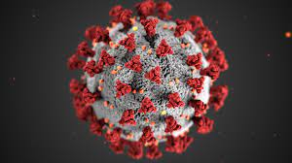
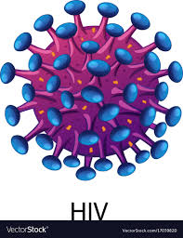
CHAPTER 1.1

Slide 3
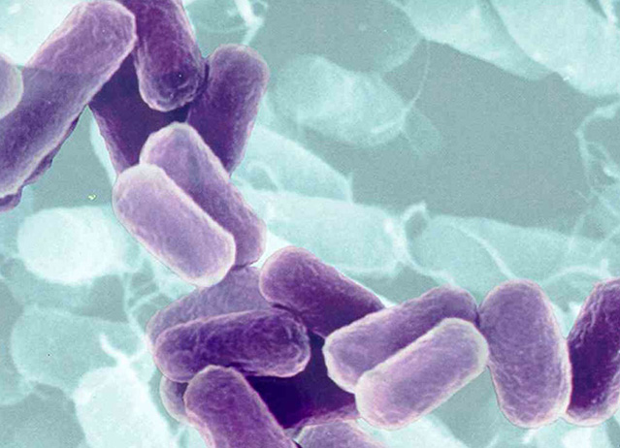
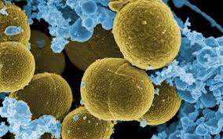
CHAPTER 1.1

Slide 4
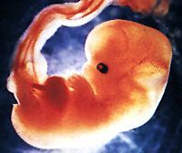
CHAPTER 1.1

Slide 5
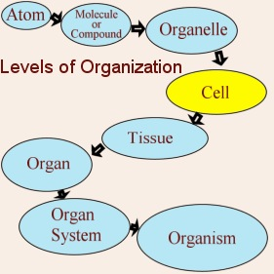
1.1 Characteristics of Life (p.3)
Living Things Are Organized
Cells (Nerve cell)
Tissues (Nervous tissue)
Organs (Brain)
Organ Systems (Brain, Spinal cord…etc)
Organism (Human)

Slide 7
2. Living Things Acquire Materials and Energy
Energy is the capacity to do work.
Living things cannot carry on life’s activities without an outside source of materials and energy
Autotrophs or Photosythesizers use carbon dioxide, water and solar energy to make their own food
Heterotrophs (humans) acquire materials and energy when they eat.

Slide 8
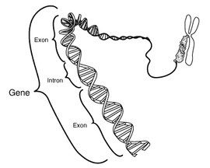
3. Living Things Reproduce
Life creates life.
Genes in the form of DNA (deoxyribonucleic acid) allow cells and organisms to reproduce.
Metabolism is all the chemical reactions in the cell.
Reproduction can be asexual (mitosis) or sexual (meiosis).

Slide 9
4. Living Things Respond to Stimuli
Stimuli (a stimulus) is a change in the internal or external environment that a sensory receptor can detect.
Behaviour is the response to a stimulus.
Behaviour is generally a response designed to minimize injury, to acquire food, and/or to increase reproduction.

Slide 10
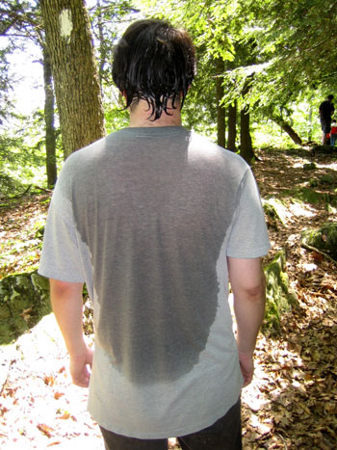
5.Living Things are Homeostatic
Homeostasis means “staying the same.” It is the relative constancy of the body’s internal environment.
All organ systems work together to maintain homeostasis.
Ex: Humans try to maintain a body temperature of 37ºC regardless of how hot or cold the environment is.

Slide 11
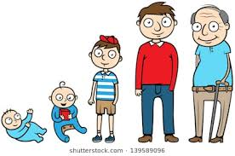
6. Living Things Grow and Develop
Growth is the increase in the size and often the number of cells.
Growth is a part of development.
Development is all the changes that take place between conception and death. (Ex: egg, zygote, embryo, fetus, baby, adolescence, adulthood, aging).

Slide 12
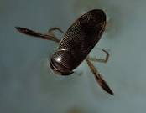
7. Living Things are Adapted
Adaptations are modifications that make an organism suited to its way of life.
Evolution is the process by which a species changes through time.
Species are groups of similarly constructed organisms that can interbreed.
Evolution is the key to the diversity of life.

