Slide 1
Acids, Bases and Buffers
Chapter 2 pg. 28-29

Slide 2
Characteristics of Acids
Acids are solutions with a greater number of __________ ions (H⁺) than __________ (OH⁻)
Acids taste ___________.
Acids turn __________ litmus paper ____________.
Acids have a _____________below __________.
Examples of acids include stomach acid, lemon juice, ___________, vinegar, ____________ and rain water.

Slide 3
Characteristics of Bases
Bases have a greater concentration of _____________ ions than hydrogen ions.
Bases taste ________________.
Bases feel ________________.
Bases turn ___________ litmus paper ___________.
Bases have a __________ greater than ____________.

Slide 4
The pH Scale.
The pH scale measures how _________or basic a solution is.
The pH scale ranges from __________. A pH less than 7 is an ________solutions and a pH greater than 7 are _________.
pH means “________ _______________ ions”.
pH=7 is ________________= 1 x 10⁻⁷ hydrogen ion concentration.
H₂O ___________ + _____________
___________________ reactions: when an acid is added to base the product is a _________ and _______________.
HCl + NaOH ________ + ____________

Slide 5
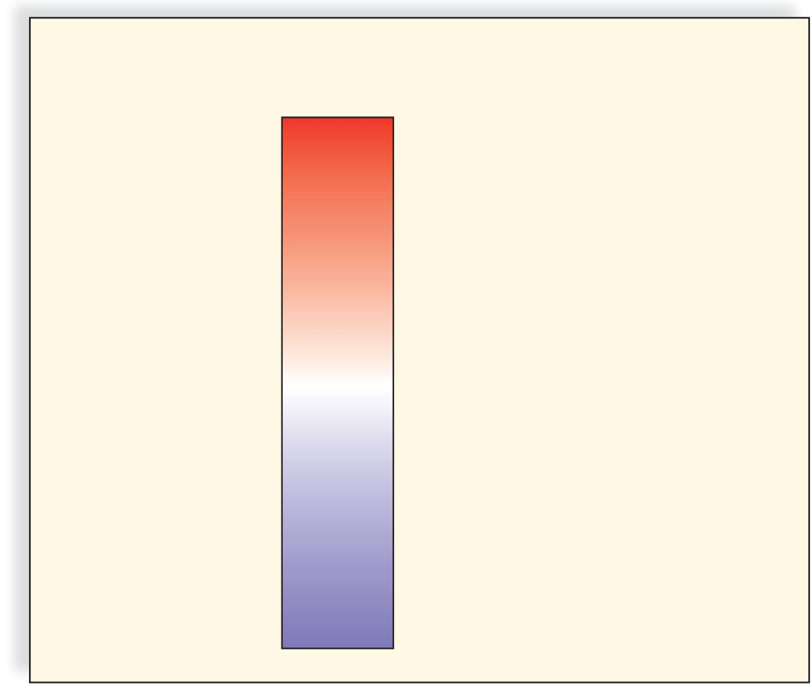
The pH Scale
Copyright © The McGraw-Hill Companies, Inc. Permission required for reproduction or display.
H⁺ Ion
Concentration
pH value
Examples
10 ⁰
0
hydrochloric acid
10^{–1}
1
stomach acid, lemon
juice
10^{–2}
2
acidic
10^{–3}
3
vinegar, cola, beer
10^{–4}
4
tomatoes
10^{–5}
5
black coffee
10^{–6}
6
urine
10^{–7}
7
pure water
10^{–8}
8
seawater
10^{–9}
9
baking soda
10^{–10}
10
Great Salt Lake
basic
10^{–11}
11
household ammonia
10^{–12}
12
household bleach
10^{–13}
13
10^{–14}
14
sodium hydroxide

Slide 6
Buffers
A buffer is a chemical or combination of chemicals that keep the __________ in a normal range.
Buffers resist pH changes by absorbing excess __________(H⁺ ions) or __________ (OH⁻ ions).
Buffers in the _____________maintain the pH between ________ and ___________
Buffers in the __________ maintain the pH at _________ because of carbonic acid ____________ and bicarbonate ions _____________
H₂CO₃ ________ + ___________

Slide 7
Buffers in Biology
Health of organisms requires maintaining pH of body fluids within _________________ limits
Human blood normally _______ (slightly ___________)
Many foods and metabolic processes add or subtract _________ or __________ ions
Reducing blood pH to 7.0 results in _______________
Increasing blood pH to 7.8 results in _______________
Both life threatening situations!

