Slide 1
An Introduction to Genetics
Who to Blame?

Slide 2
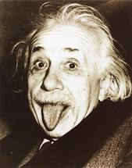
Tongue Rolling?
Notes:
Rolling = dominant
Lack of Rolling = recessive

Slide 3
Earlobe Attachment?
Notes:
Dominant = free
Recessive = attached

Slide 4
Cleft Chin
Notes:
Cleft chin = dominant
Smooth chin = recessive

Slide 5
Dimples?
Notes:
Dimples = dominant
Lack of dimples = recessive

Slide 6
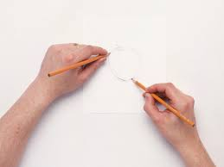
Righty or LeftY?

Slide 7
Freckles?

Slide 8
Naturally curly Hair

Slide 9
Hand clasping: R over L or L over R?

Slide 10
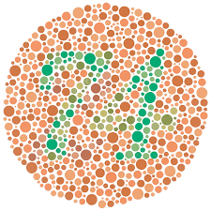
Colourblindness?

Slide 11
Allergies?

Slide 12
Hairline? Straight or widow’s peak?

Slide 13
All thumbs

